Slide 1
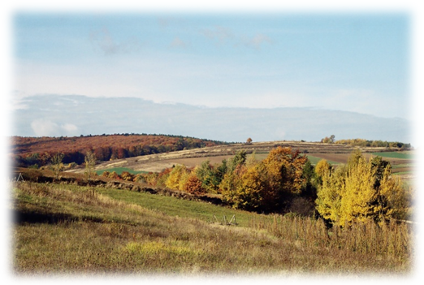
Roźwienica and its nearby villages delight the visitors with nice atmosphere and hospitality of local community. Roźwienica covered with stunning forests makes it even more attractive.
We are proud of who we are, where we are from and we want to share our joy and pride with our friends.

Slide 2
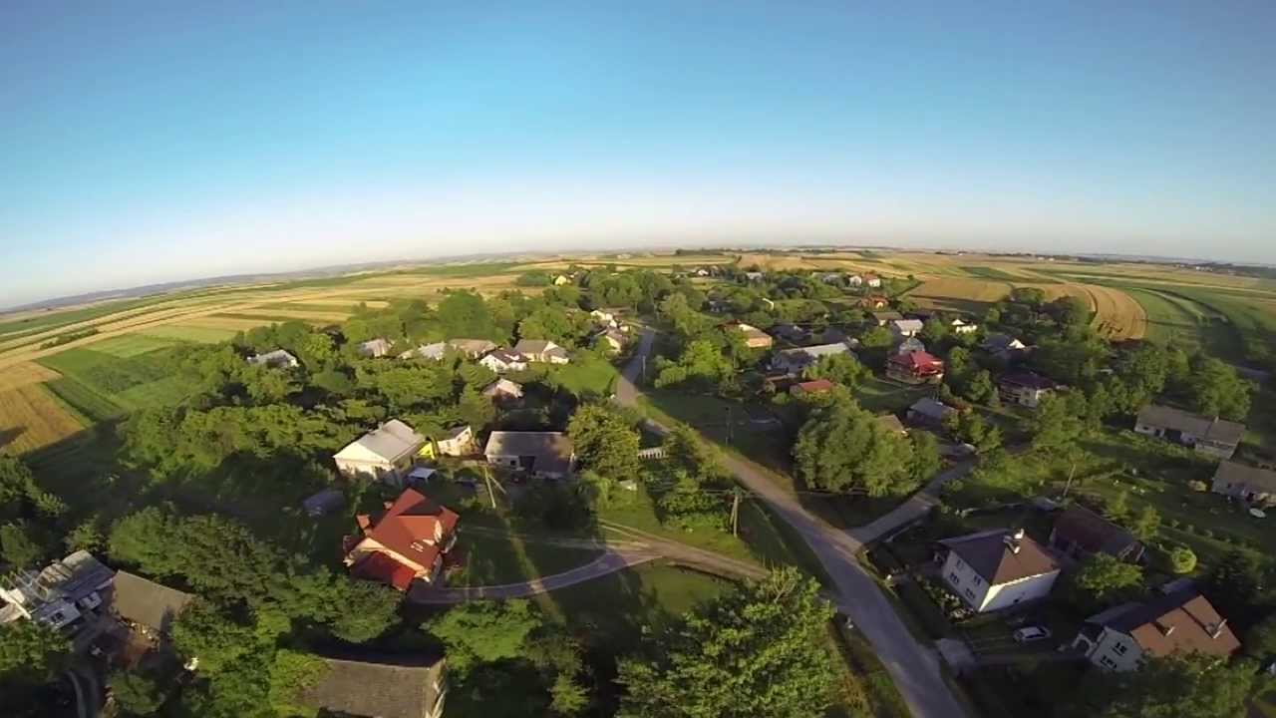
Places in the area

Slide 3
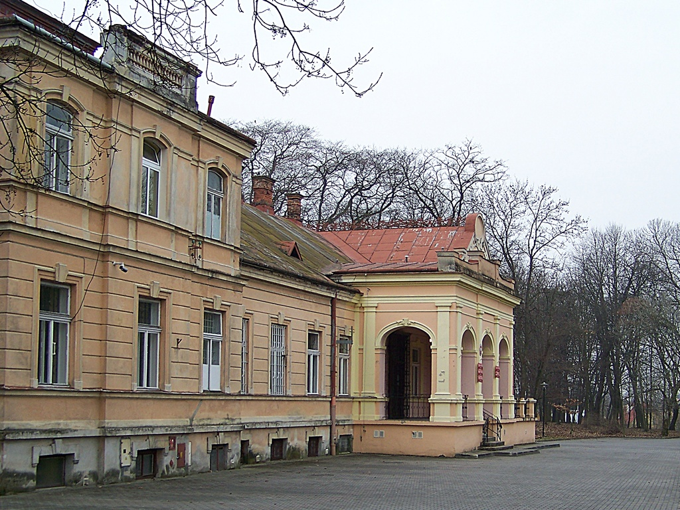
The seat of
borough leader
It is on a small hill and on the list of the national register of historic monuments. Interior of the building used to be embellished with stylish furniture, a library and a great collection of paintings. At present it is the seat of the borough leader

Slide 4
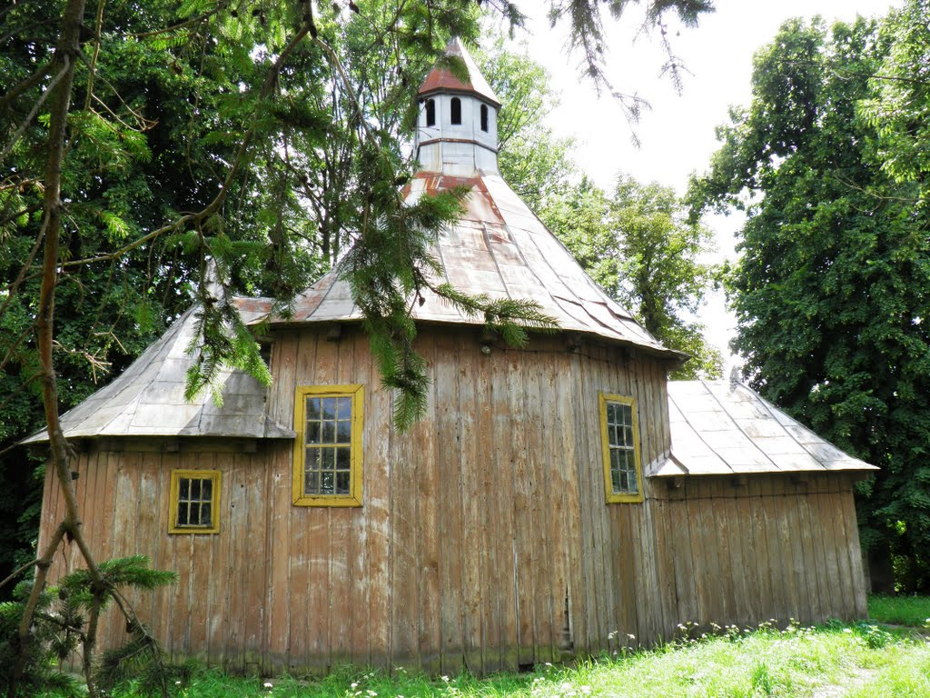
The Orthodox Church in Tyniowice
Church probably dates from 1709.A three-part timbered church is placed on a stone foundation. The main room is a nave of the church, covered with a roof and a bell tower on the top. Between 1947 and 1980 the church served as the Roman Catholic Church

Slide 5
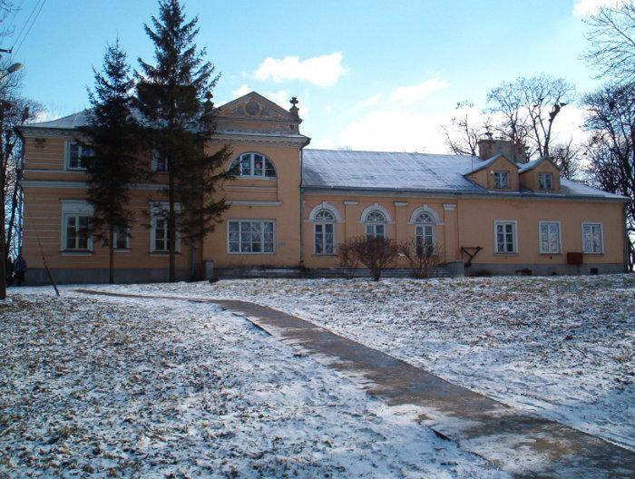
Drochojowski Palace
in Rudolowice
The palace was built at the
beginning of XIX century.
After II WW it was adopted for Plant Breeding Institute.
Till the end of 80s in the buildind
there was a hospital hard.
Then the building was arranged for school that has been exciting ever since.

Slide 6
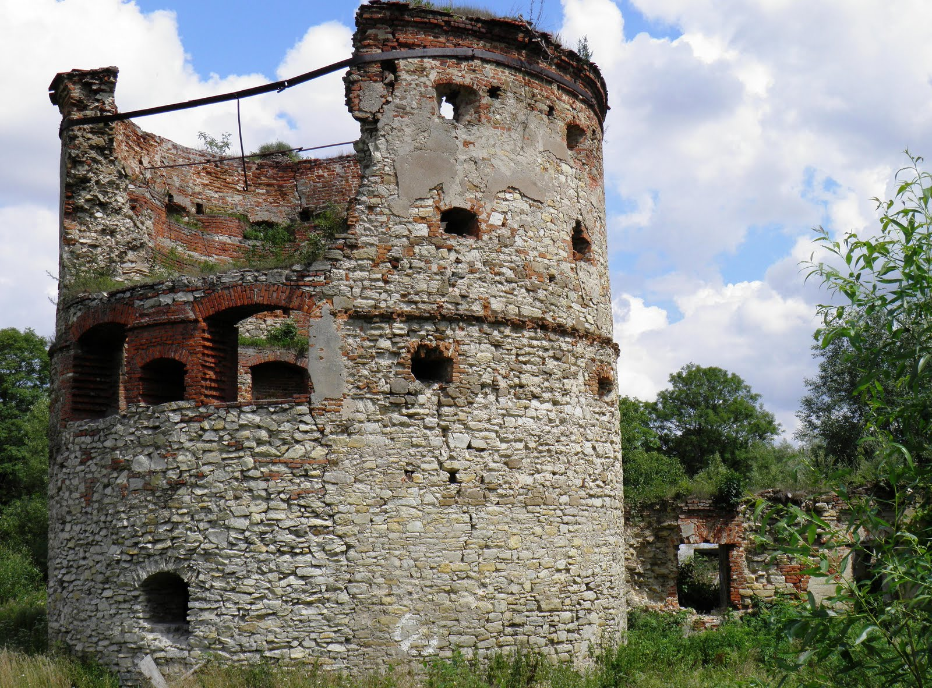
The ruins of towers
Only the north-west round tower has been saved and a piece of west wing where people used to live. The thick walls with holes used for shooting were built of stone and brick. Unfortunately there is no roof so the condition of the round tower is getting worse and worse.

Slide 7
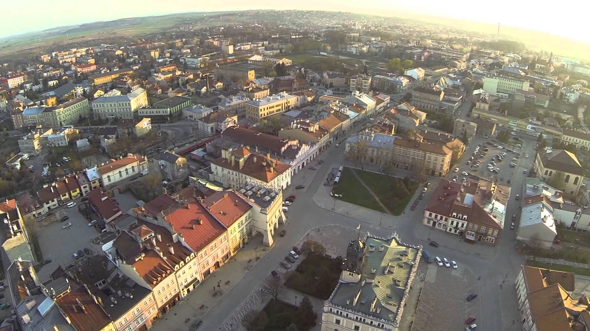
Jarosław

Slide 8
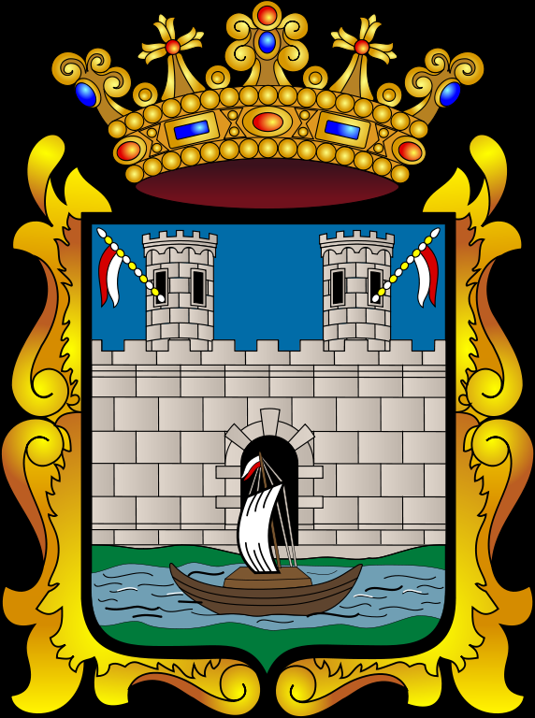
Jarosław
Jarosław is a historical town on San river.
The town used to be famous for its fairs.
Jarosław used to be on the amber route, and it was the second biggest trade centre in central-east europe.
It used to be a town of three different cultures: Polish, Ukrainian and Jewish.
It is the capital of Jarosław County.

Slide 9
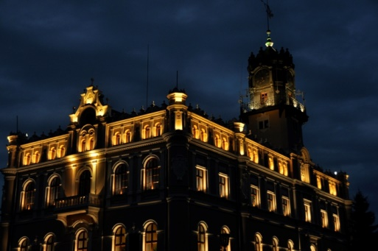
Intresting places
and unique buildings in Jarosław

Slide 10
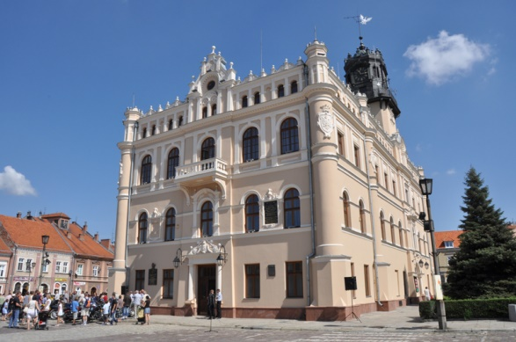
Town Hall
The seat of local authorities.
In 1852 purchased by town from the Austrian authorities.
Many times rebuilt and renovated.

Slide 11
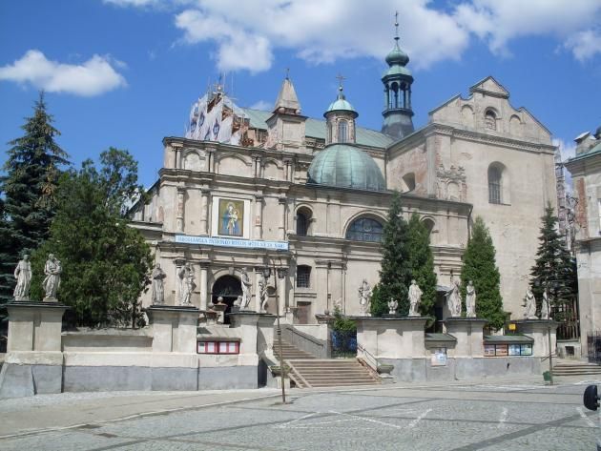
Collegiate Church
It is the oldest church built by Jesuit in Poland in 16th century.
After the great fire in 1600 it was renovated.
In 19th century the temple was bought by Adam Czartoryski.
the walls are decorated with Leonard Winterowski’s paintings.

Slide 12
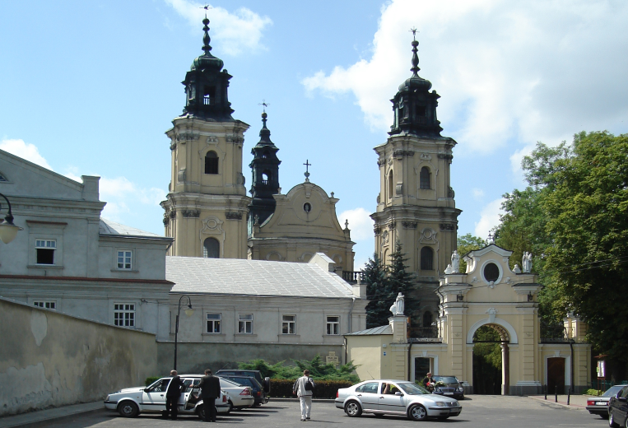
Dominicam Monastery
First a wooden chapel was built, pilgrims from far away came to visit the place- including Queen Jadwiga in 14th century and Jan III Sobieski in 17th century.
In the 19th century the authorities changed part of the monastery into barracks. The monastery and the church survived wars.
In 1966, Pope Paul VI named the church a minor basilica, and in 1970 it became a parish church.

Slide 13
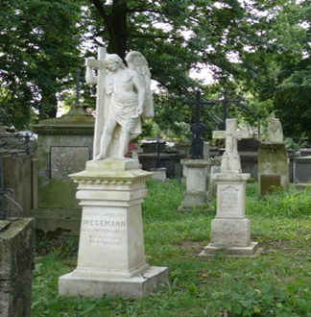
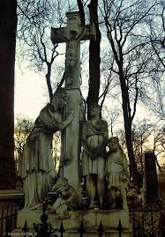
Old Cemetery
one of the oldest cemeteries in Europe.
In the cemetery there are graves of generations of citiziens of Jarosław,

Slide 14
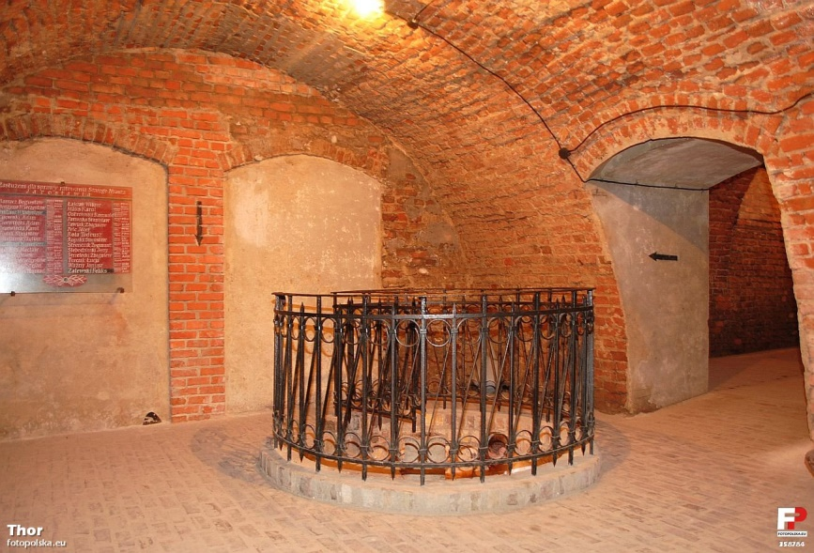
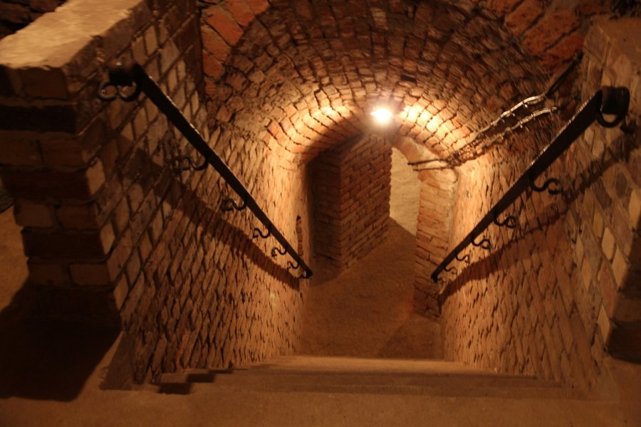
The Underground
Tourist Route
The two-storey underground route is about 150 metres long and down to 8.5 metres deep.

